Slide 1
Groundwater Planning & Management in Texas
Natalie Ballew, P.G.
League of Women Voters of the Comal Area
September 24, 2025

Slide 2


Texas Water Development Board
DATA & SCIENCE
$
PLANNING
FINANCE
Notes:
3 main functions
collect data and conduct scientific investigations for the state’s water resources
support the development of regional water plans and compile them into the state water plan
provide loans to local governments for various water-related projects.
Data & Science where I work – support groundwater conservation districts, collect data, develop models, answer all sorts of questions
As one of our former Board members liked to say, “The better the data, the better the science; the better the science, the better the planning; the better the planning, the better the projects”

Slide 3


What we’ll talk about
Joint Groundwater Planning
Groundwater Management: Who does what?
Notes:
A brief Groundwater 101
Aquifers in Bandera County, including how drought has impacted them
Groundwater planning and how you can get involved.
Roles in GW Management: who manages our GW

Slide 4
GMAs, GAMs, MAGs…OMG!
GCD
GMA
DFC
TWDB
GAM
MAG
RWPG
Groundwater conservation district
Groundwater management area
Desired future condition
Texas Water Development Board
Groundwater availability model
Modeled available groundwater
Regional water planning group
Notes:
There are lots of acronyms involved in the joint groundwater planning process. Here’s a list for your reference.

Slide 5
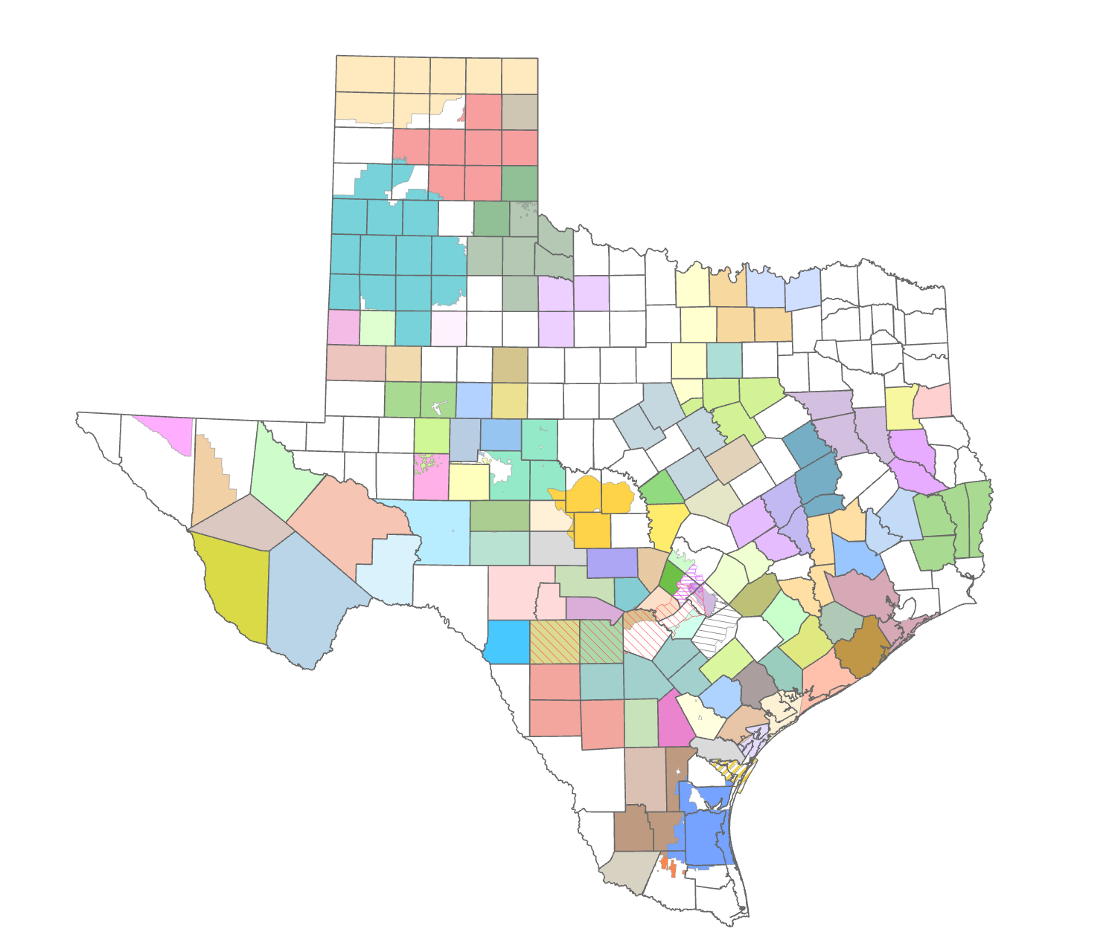
Groundwater conservation districts (GCDs)
Preferred method of groundwater management in Texas
Notes:
Groundwater conservation districts (GCDs) are the entities that manage groundwater at the local level in Texas. There are about 100 GCDs in Texas, shown on this map as the counties filled with color. GCDs are the state’s preferred method of groundwater management.
A GCD’s powers and duties are outlined in Chapter 36 of the Texas Water Code, but their fundamental mandate is to manage groundwater in order to protect property rights, balance conservation and development of groundwater to meet the needs of Texas and use the best available science in the conservation and development of groundwater through rules developed by each district.

Slide 6
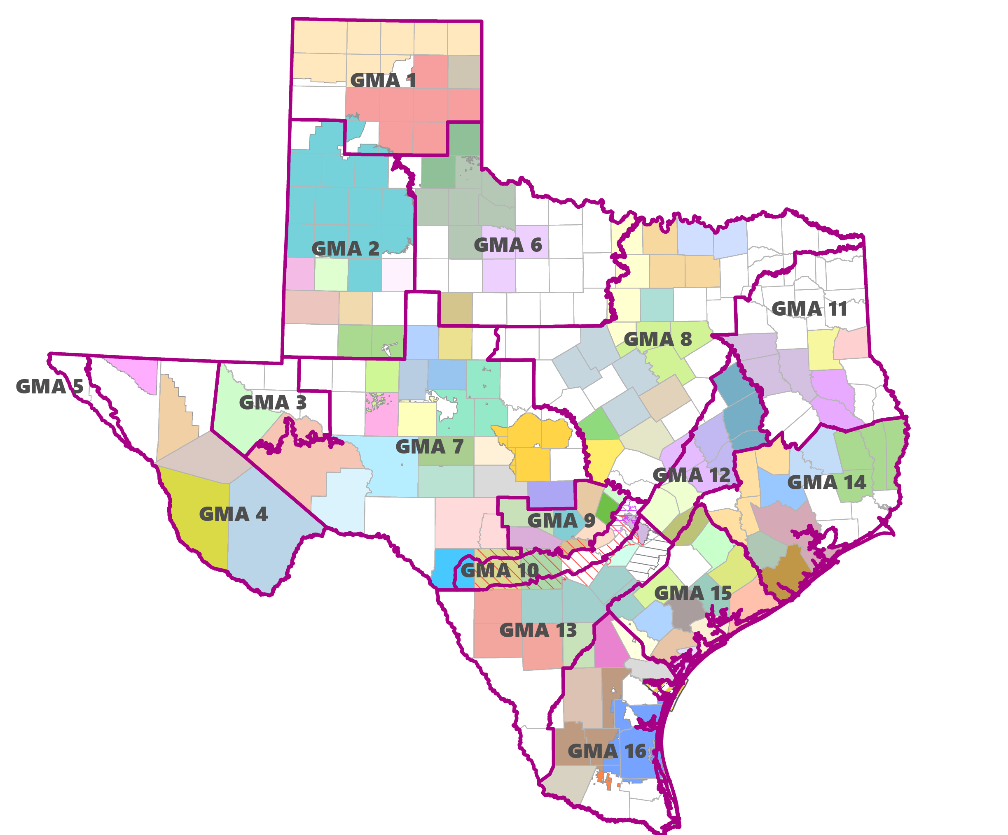
Groundwater management areas (GMAs)
Groups of groundwater conservation districts (GCDs)
Notes:
GCDs are grouped into groundwater management areas (GMAs). There are 16 GMAs that cover all the aquifers in the state. The idea behind GMAs is so that districts overlying a shared aquifer can plan regionally for the future of those groundwater supplies.

Slide 7
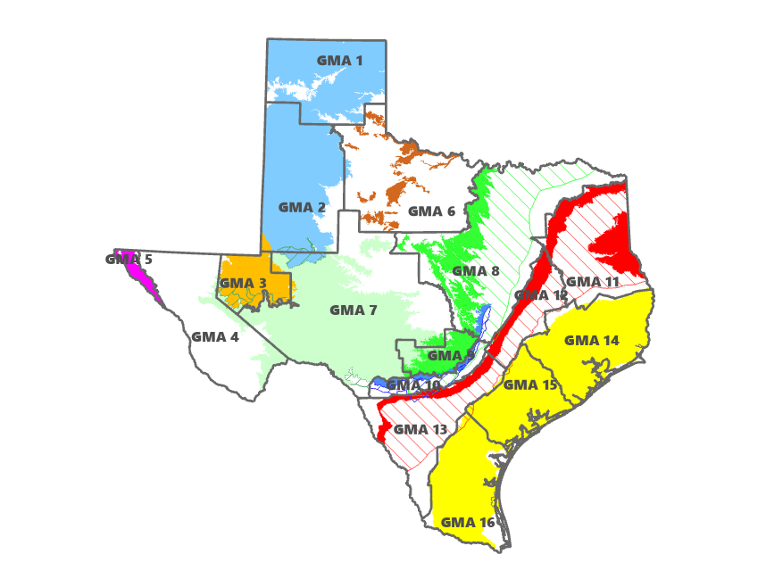
Groundwater management areas (GMAs)
Generally follow major aquifer boundaries
Notes:
GMAs are delineated by the TWDB, and generally follow major aquifer boundaries.

Slide 8

Joint Groundwater Planning

Slide 9
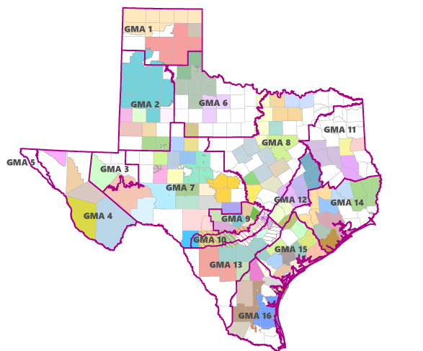
Groundwater management areas (GMAs)
Groups of groundwater conservation district (GCDs)
Notes:
GMAs – TWDB delineates GMA boundaries; originally proposed delineation based on major aquifer boundaries, but then morphed into a mix of aquifer/county boundaries based on GCD feedback. We have made several adjustments to the boundaries since their original delineation to align more with the aquifer and to allow GCDs to focus on participating in joint groundwater planning in areas with shared groundwater resources. While the TWDB can make changes to the boundaries on their own, it’s best if any requests for changes come from the districts.
Regional groundwater planning
Share management plan info
Develop DFCs

Slide 10
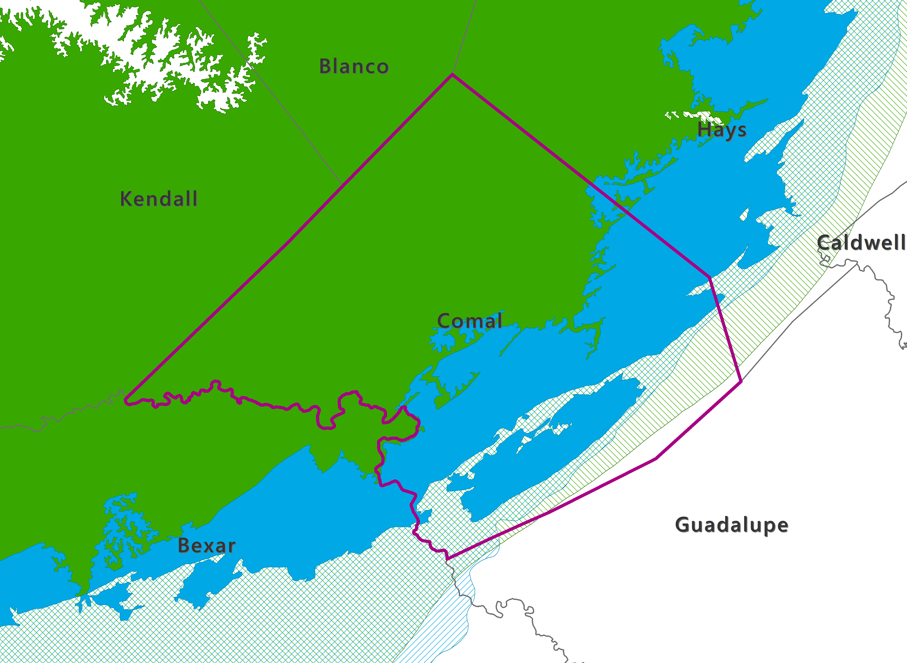
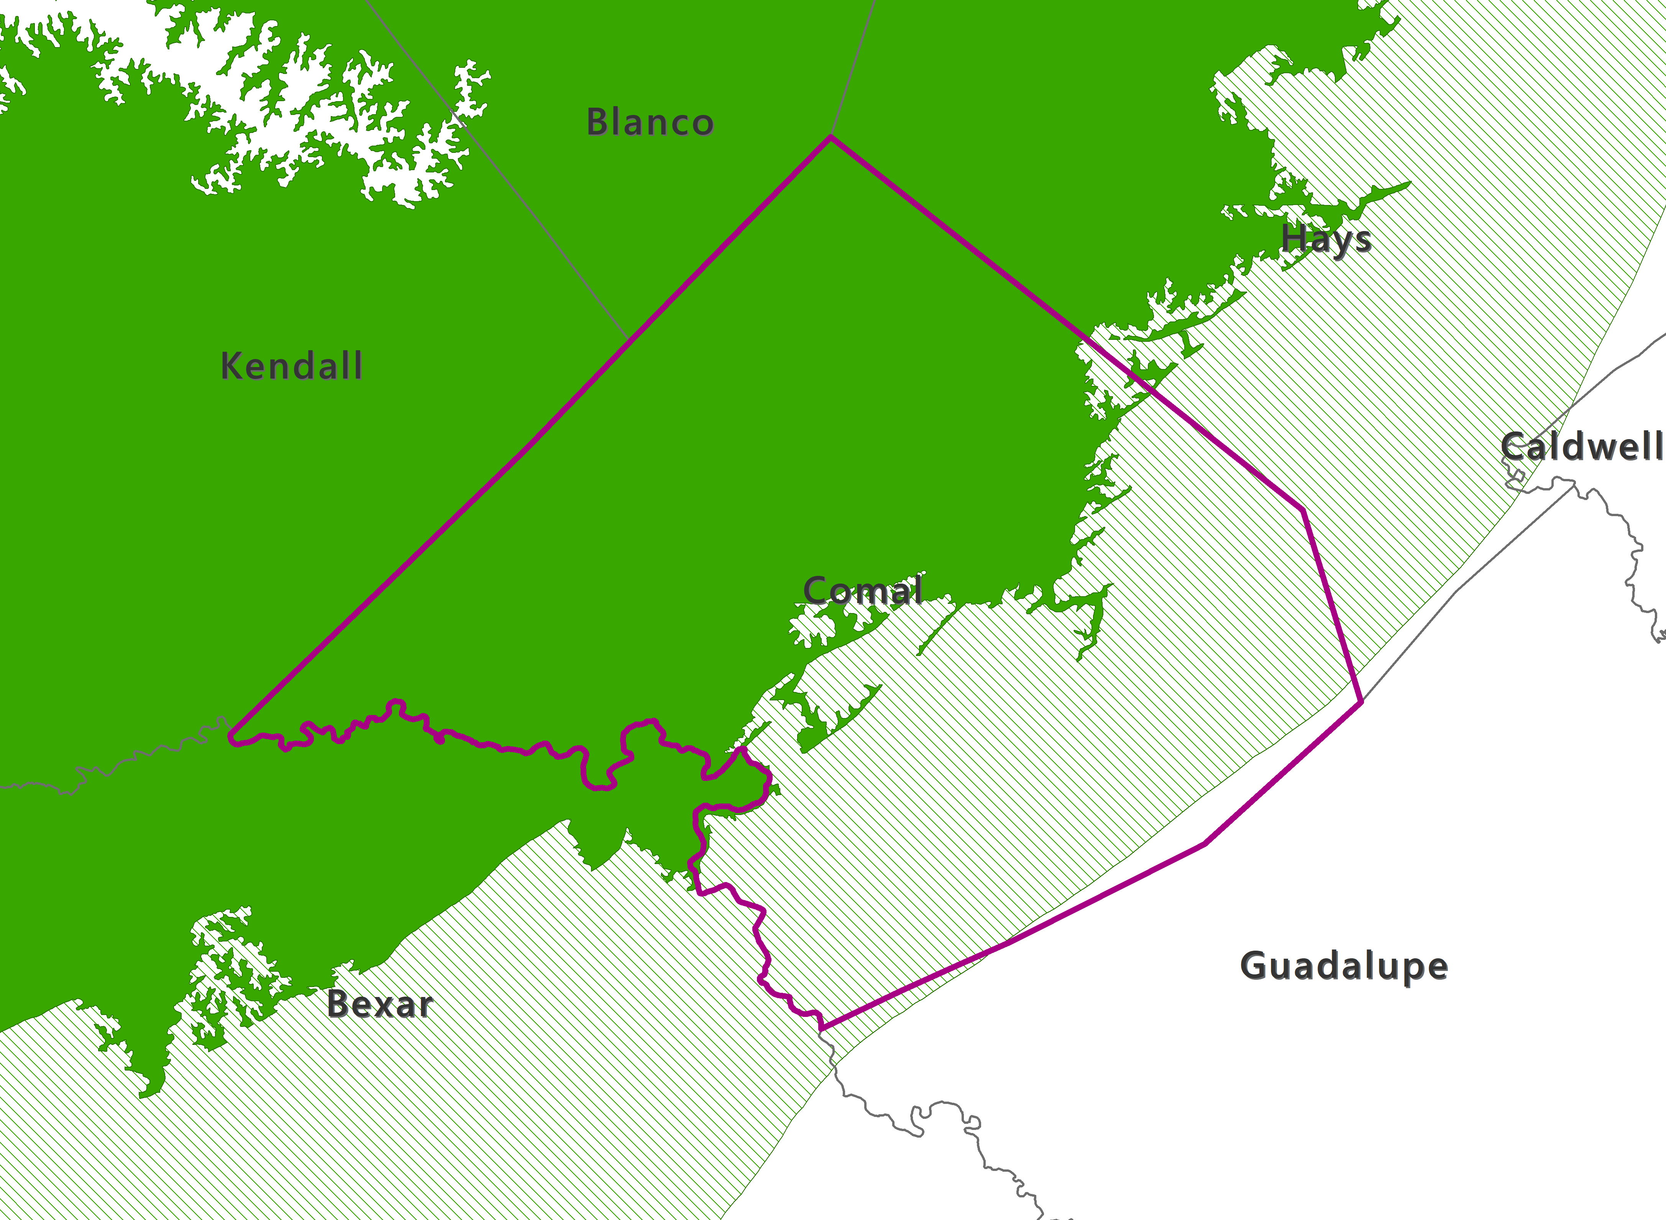
Trinity Aquifer (outcrop/unconfined)
Trinity Aquifer (subcrop/confined)
Edwards (BFZ) Aquifer (outcrop/unconfined)
Edwards (BFZ) Aquifer (subcrop/confined)
Notes:
Zooming into Comal County
Confined/Unconfined vs. Outcrop/Subcrop

Slide 11
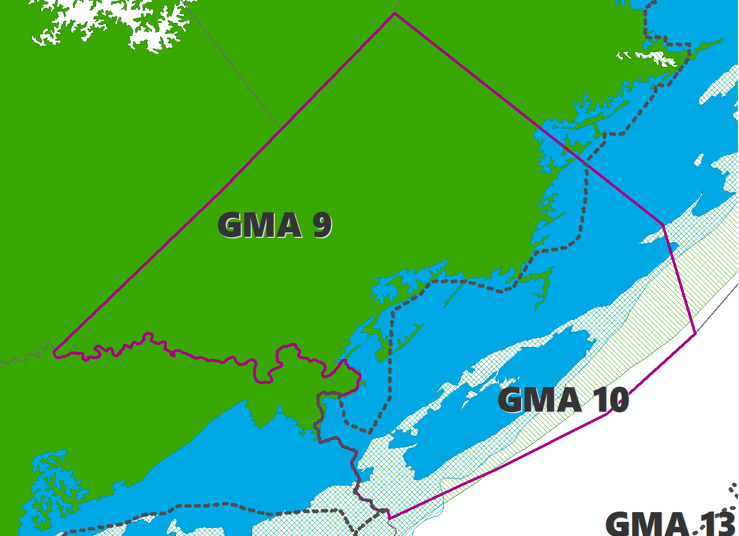

Slide 12
What is joint planning?
District representatives in a GMA meet at least annually to conduct joint planning:
review GMA accomplishments
propose to adopt new or amended desired future conditions (at least once every 5 years)
review management plans (impact of goals on planning, effectiveness of measures to conserve, district achievement of desired future conditions)
Texas Water Code § 36.108
Notes:
Majority of activities are related to establishing DFCs.
Funding for joint planning comes from districts, unlike funding for regional water planning groups, which is funded by TWDB grants.

Slide 13
Desired future conditions
DFCs
Broad policy goal
Quantitative description
Updated at least every 5 years
Used to determine future groundwater availability
Drawdown, springflow, storage volume, etc.
May be established for:
aquifer
aquifer subdivision
geologic strata
geographic area

Slide 14
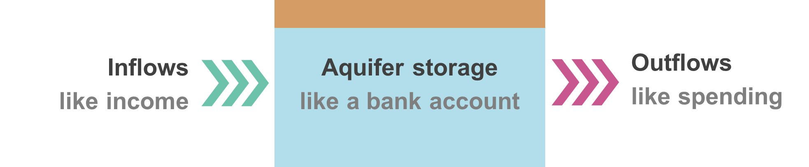
DFCs and MAGs
In bank account terms
Desired future condition
in 50 years
Modeled available groundwater
for next 50 years
No more than 30 feet of drawdown
like maintain a minimum balance of $x
Pumping 50,000 acre-feet per year will achieve the desired future condition
Spending $x will achieve the
desired future condition
At least 40% volume in storage
like maintain $x in savings
Maintain at least 100 acre-feet per month of spring discharge to creek
like maintain $x funds to cover annual fees

Slide 15
Groundwater management
Groundwater planning
GCDs & advisors
GMA
GCD monitors and tracks DFCs
State water plan
Set desired future conditions
Policy
TWDB groundwater availability models
Science
GCD management plans & rules
Modeled available groundwater
Regional water plans
Groundwater availability
Notes:
This flow chart visually describes the iterative process for establishing DFCs including the application of the best available science through use of the groundwater availability models (GAMs) to produce groundwater availability estimates know as Modeled Available Groundwater or MAGs. The MAGs have two important functions:
Water Supply Planning - determines the amount of groundwater available for regional and state water planning (path to the left of the flow chart)
Groundwater Management - Informs permitting and regulatory decisions by GCDs.
Note that this process occurs every five years to align with state water planning and requires ongoing monitoring of aquifer conditions to measure compliance with DFCs.

Slide 16
Groundwater Management
Who does what?

Slide 17
Groundwater conservation districts

Slide 18
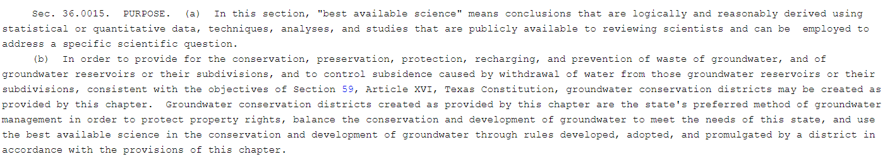
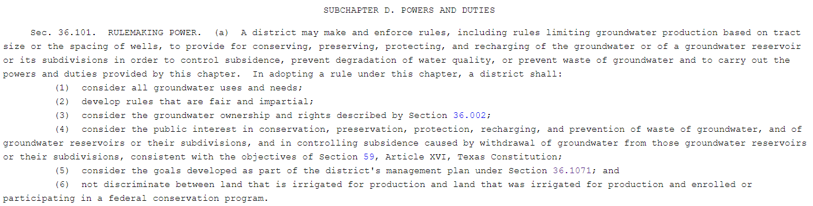
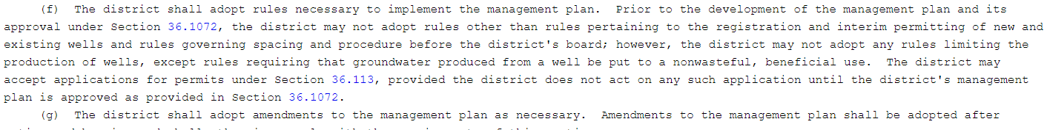

Slide 19
Fundamental mandate
Balance protection of property rights, conservation, and development of groundwater using best-available science

Slide 20
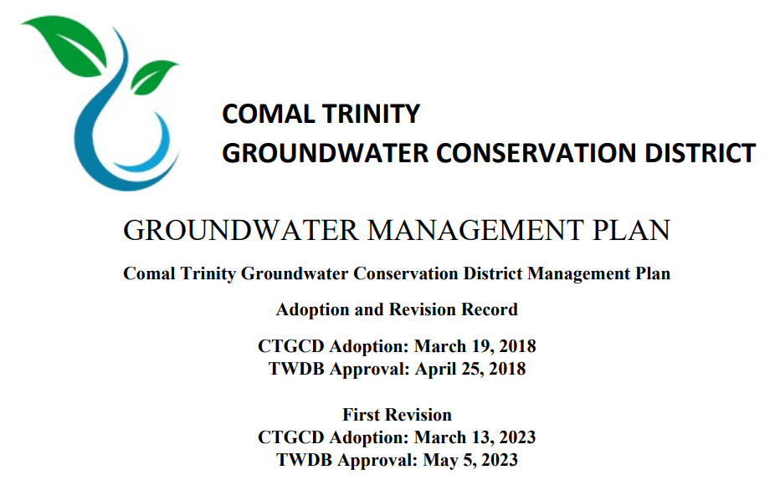

Slide 21
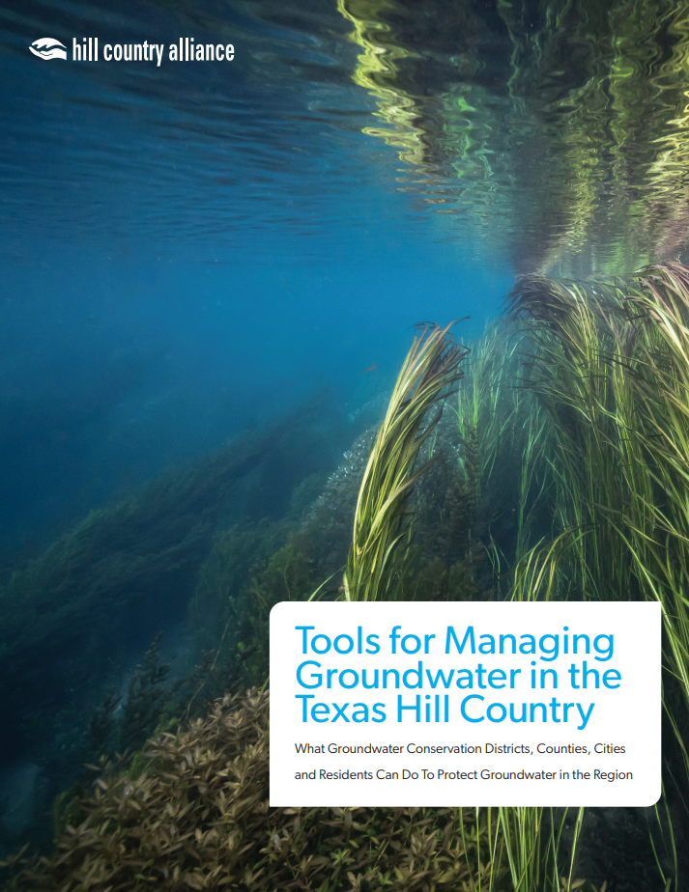
hillcountryalliance.org/wp-content/uploads/2023_HCA_ManagingGroundwater_Paper.pdf

Slide 22
GCD tools
Well spacing and pumping limits
Water use reports
Drought contingency plans
Management zones for local conditions
Production curtailments to achieve desired future conditions
Develop science to inform decision making
Education and outreach
From hillcountryalliance.org/wp-content/uploads/2023_HCA_ManagingGroundwater_Paper.pdf
Notes:
spacing between wells, wells and property lines, based on lot size.
Issue permits that limit pumping for nonexempt wells
Reporting for permitted users, sometimes metering
Curtailments when in drought and when achieving DFC is threatened
Local management zones (for either limited or more pumping)

Slide 23
County & city tools
Water availability requirements for new subdivisions
Conservation development incentives
Minimum lot sizes for lots with septic systems and water supply wells
Invest in land protection to promote recharge
Strong drought contingency plans + enforcement
Promote low impact development practices
Encourage rainwater harvesting and other alternative water sources
Invest in wastewater reuse
From hillcountryalliance.org/wp-content/uploads/2023_HCA_ManagingGroundwater_Paper.pdf
Notes:
In Comal County, subdivision applicants must prove their water supplier can provide water for their subdivision and all subdivisions that the water supplier has committed to serve for the next 20 years. The county has denied several subdivision proposals due to this.
Lot size requirements by a county can complement GCD’s well density regulations
Incentives to protect aquifer recharge with new development
Protect recharge areas and aquifer health, complementing GCD efforts

Slide 24
How you can get involved
Get to know your GCD
Engage with your elected officials
Support scientific development
Practice groundwater stewardship
Share concerns at public meetings
From hillcountryalliance.org/wp-content/uploads/2023_HCA_ManagingGroundwater_Paper.pdf
Notes:
Check out your GCD website, follow their social media, learn your local aquifers to understand production capabilities and water quality issues, local water well drilling and well usage. Get to know board members, many of whom represent precincts within a district.
Elected officials (Comal County GCD board is appointed by County Commissioners)
Science: districts must use the best available science. Exempt wells, allow access for monitoring.
Stewardship: native plants, rainwater, conservation
Attend public GCD, county, and city meetings. Desired future conditions, GCD management plans, and county/city rules and regulations are all developed through public participation

Slide 25
Natalie Ballew, P.G.
Groundwater Division Director, TWDB
512-765-0532
natalie.ballew@twdb.texas.gov

